Slide 1


Department of Information & Science Engineering
Review-2 Presentation on
“LEG AND HANDBONE FRACTURE CLASSIFICATION USING DEEP LEARNING ”
By
Nagaranjini Singh R J (4GW21IS026)
Nithyashree C K (4GW21IS030)
Thanushree M N (4GW21IS052)
Lavanya M (4GW22IS403)
Under the guidance of
Anitha Rao
Assistant Professor
Dept. of ISE, GSSSIETW

Slide 2


Contents
Introduction
Proposed Method
Existing system
Literature Survey
Requirements :
Hardware Requirements
Software Requirements
System Architecture
Data Flow Diagram
Methodology
Implementation
Screenshots
Test Cases
Conclusion
References

Slide 3
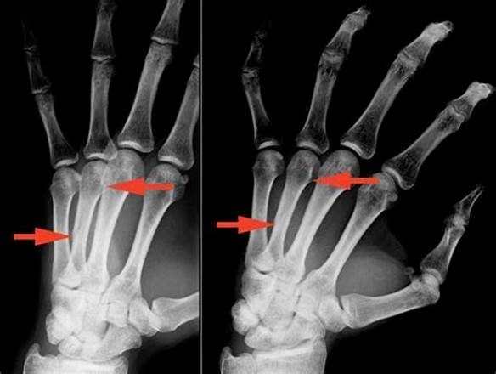
Introduction
Bone fractures, particularly in the leg and hand, are common injuries. Accurate diagnosis and classification of fracture severity are essential for effective treatment planning and recovery. With advancements in deep learning, automated systems now offer faster and more reliable solutions for medical imaging tasks. This project focuses on developing a Smart Diagnosis System using a Convolutional Neural Network (CNN) based on the VGG16 architecture.

Slide 4
Proposed System
The aim of the proposed method is to develop an automated system using the VGG16 CNN architecture to accurately classify the severity of hand and leg fractures from X-ray images.
OBJECTIVES
To create a Flask-based web interface where users can upload their X-ray images for real-time fracture classification. The system will classify the uploaded X-rays into three severity categories: Mild, Moderate, and Severe.
To Integrate heatmap visualization techniques like Grad-CAM to identify and highlight regions in X-ray images most indicative of fractures.
To enable doctors to enter patient information and treatment details after classification and generate a structured PDF report.

Slide 5
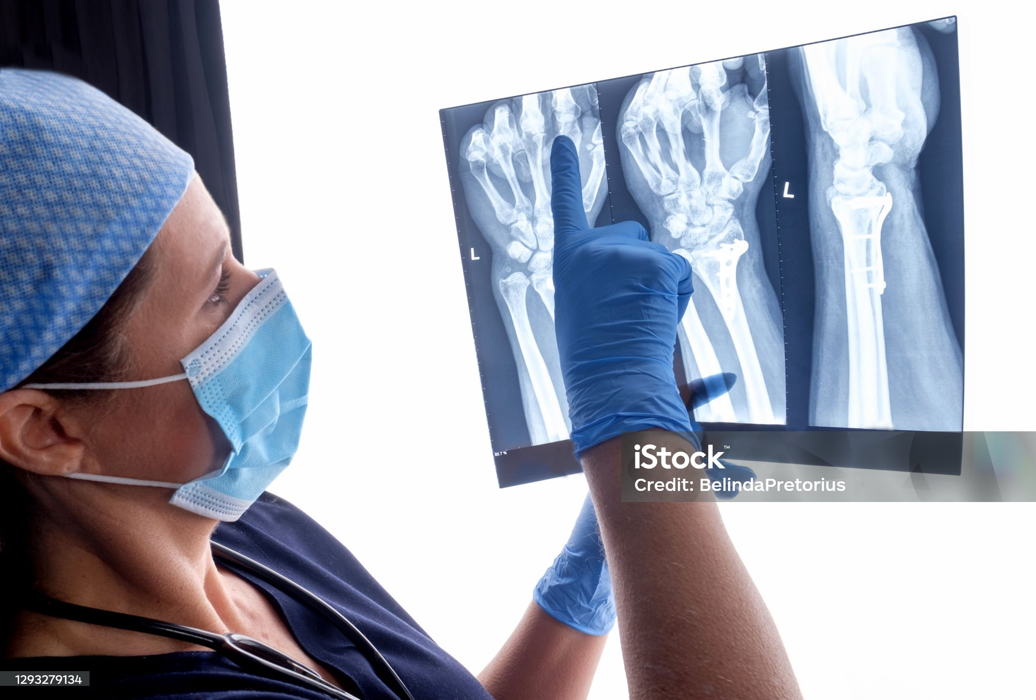
Existing System
Manual Diagnosis by Radiologists: Fracture detection primarily relies on expert radiologists manually analyzing X-ray images.
Conventional Computer-Aided Diagnosis (CAD):Basic image processing techniques (e.g., edge detection, segmentation) are used to identify fractures.
Limited Availability: Some existing tools provide basic image analysis using ML, but they not offer comprehensive classification or personalized reporting.
Inconsistent Accuracy: Accuracy often varies depending on the image quality, type of fracture, and system implementation, limiting trust in automated tools.

Slide 6
Literature Survey
SI NO | Title | Authors | Methodology | References | Year | Limitations
1 | Bone Fracture Classification using Convolutional Neural Networks from X-ray Images | Amal Alshahrani, Alaa Alsairafi | Utilized convolutional neural networks (CNNs) for classifying bone fractures from X-ray images, demonstrating improved accuracy in automated diagnostics. | Amal Alshahrani, Alaa Alsairafi, "Bone Fracture Classification using Convolutional Neural Networks from X-ray Images," 2024. | 2024 | Limited dataset diversity and real-world applicability challenges.
2 | Cross-Center Validation of Deep Learning Model for Musculoskeletal Fracture Detection in Radiographic Imaging: A Feasibility Study | Robert Hruby, Daniel Kvak | Analyzed the effectiveness of a deep learning model across multiple centers to assess fracture detection consistency in radiographic imaging. | Robert Hruby, Daniel Kvak, "Cross- Centre Validation of Deep Learning Model for Musculoskeletal Fracture Detection in Radiographic Imaging: A Feasibility Study," 2024. | 2024 | Challenges in model generalizability due to variations in imaging protocols and patient demographic
3 | Pediatric Fracture Detection with X-ray Images Using YOLOv8 | Jitendra Chautharia | Utilized the YOLOv8 deep learning model for automated detection of pediatric fractures in X-ray images, demonstrating effective performance in real-time detection. | Jitendra Chautharia, "Pediatric Fracture Detection with X-ray Images Using YOLOv8," 2024. | 2024 | Detection performance may vary with different X-ray image quality and types of fractures.

Slide 7
SI No | Title | Authors | Methodology | Reference | Year | Limitation
04 | Long Bones X-ray Fracture Classification Using Machine Learning | S.N. Kadry, H. Maghraby | The study employed machine learning techniques to classify long bone fractures in X-ray images, focusing on automated analysis for enhanced accuracy and rapid diagnostic support. | S.N. Kadry, H. Maghraby, "Long bone X-ray fracture classification using machine learning", Journal of Al-Azhar University Engineering Sector, vol. 19, pp. 121-133, 2024. | 2024 | Potential for overfitting if the model is not properly validated
05 | Fracture Detection in Wrist X-ray Images Using Deep Learning-Based Object Detection Models | M. H. Aly, A. M. Hassan, A. M. Amin | Used YOLO and Faster R-CNN for wrist fracture detection; included preprocessing and model training. | M. H. Aly, A. M. Hassan, A. M. Amin, "Fracture Detection in Wrist X-ray Images Using Deep Learning-Based Object Detection Models," Journal of Biomedical Informatics, vol. 135, pp. 142-153, 2023. | 2023 | High Requires large annotated datasets for accurate detection; potential overfitting with small datasets.
06 | Robust Medical X-Ray Image Classification by Deep Learning with Multi-Versus Optimizer | Zhang et al | The study utilized a Multi-Versus Optimizer to enhance the optimization of deep learning models for medical X-ray image classification. It aimed to improve classification accuracy and robustness by addressing data variability. | Zhang et al., "Robust Medical X-Ray Image Classification by Deep Learning with Multi-Versus Optimizer," 2023. | 2023 | The model is sensitive to noise and variations in input data, which can affect classification performance.

Slide 8
SI. No | Title | Authors | Methodology | Reference | Year | Limitation
08 | A Deep Learning Approach for Fracture Detection in Radiography | K. M. Cheng, A. P. Ho, Z. Niu | Dense Net: Uses densely connected layers that improve feature reuse and gradient flow for better performance on complex images. | Cheng, K. M., Ho, A. P., & Niu, Z. "A Deep Learning Approach for Fracture Detection in Radiography." Journal of Medical Imaging, vol. 6, no. 1, 2022. | 2022 | Dense Net may require higher processing power and memory.
09 | Automatic Detection of Bone Fractures in X-rays Using Deep Learning Models | S. Bar, G. Diamant, D. Wolf | InceptionV3: Utilizes multiple filter sizes in the same module for efficient feature learning and improved classification. | Bar, S., Diamant, G., & Wolf, D. "Automatic Detection of Bone Fractures in X-rays Using Deep Learning Models." Medical Imaging Research, vol. 9, no. 4, 2021 | 2021 | May not perform equally well on all types of X-ray images.
10 | Detection of Bone Fractures from X-ray Images Using Faster R-CNN | R. S. Yadav, P. K. Shrivastava | Faster R-CNN: Uses a Region Proposal Network (RPN) for precise object detection and classification, suitable for localizing fractures | Yadav, R. S., & Shrivastava, P. K. "Detection of Bone Fractures from X-ray Images Using Faster R-CNN." Computer Vision in Medicine, vol. 12, 2020. | 2020 | Performance can vary based on image quality and conditions.

Slide 9
System Requirements
1
Hardware Requirements
2
Software Requirements
Processor: Intel i5 or higher
RAM: Minimum of 8 GB, with 16 GB recommended for smoother training and processing of images.
Operating System: Windows 10/11 (64-bit)
Programming Language: Python 3.8 or higher.
Libraries: TensorFlow, OpenCV, Flask, NumPy, Pillow, Matplotlib, Werkzeug.
Framework: Flask
IDE/Code Editor: VS Code

Slide 10
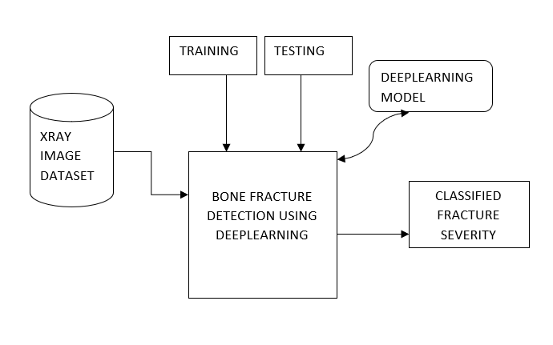
System Architecture
X-Ray Image Dataset: Serves as the input source for the system, containing labeled X-ray images of fractures.
Bone Fracture Detection Using Deep Learning: Processes the dataset by splitting it into training and testing sets. Utilizes a deep learning model, such as VGG16, for feature extraction and classification.
Output: The system classifies fractures into their respective severity levels (Mild, Moderate, Severe).

Slide 11
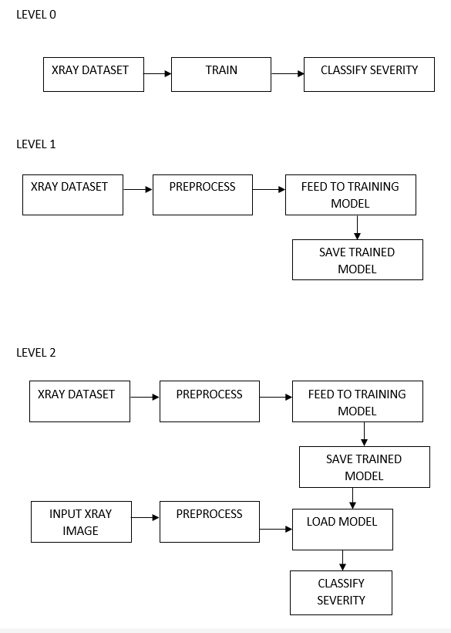
Data Flow Diagram
Level 0
The system begins with the X-ray dataset, which is processed by the model to output the classified severity of fractures.
Level 1
Training Phase: The X-ray dataset undergoes preprocessing to improve the data quality, then it is fed into the deep learning training model, which generates and saves the trained model.
Output Phase: The trained model is ready for classification tasks.
Level 2
Training Phase: X-ray datasets are preprocessed to resize, normalize, or augment the images. Preprocessed data is used to train a model that learns patterns of fractures. The trained model is saved to a file system for reuse in classification.
Testing Phase: Input X-ray images are preprocessed similarly to the training images. The preprocessed images are evaluated using the saved trained model. The fracture severity is classified and returned as the final output.

Slide 12




Methodology
Data Collection and Preprocessing:
Collect X-Ray Images: Download datasets from public medical repositories like Kaggle.
Ensure images are labeled as Mild, Moderate, or Severe.
Preprocessing: Standardize all images (e.g., 224x224 pixels) and apply grayscale conversion,
normalization, augmentation and Rotations to improve model accuracy.
Model Architecture and Training:
Utilize the pre-trained VGG16 architecture for feature extraction and implement transfer learning by replacing the top layers with custom fully connected layers for fracture classification, training the model with categorical cross-entropy loss.
Model Evaluation:
Split the dataset into training, validation, and testing sets; monitor performance metrics to assess
accuracy.
Apply techniques like dropout and early stopping to prevent overfitting and ensure the model
generalizes well to new data.
Development of Flask Web Application:
Create a user-friendly web application using Flask, allowing users to upload X-ray images.
Integrate the trained VGG16 model for real-time fracture classification and display classification
result.

Slide 13
Implementation
VGG16 - A Deep Convolutional Neural Network
Pretrained models for transfer learning.
Widely used for image classification tasks.
Architecture: 16 weight layers (13 convolutional + 3 fully connected).
Small Filters: 3x3 convolutions for detailed feature extraction.
Max Pooling: 2x2 layers for dimensionality reduction.
Activation:
ReLU: Used in all hidden layers of VGG16 and Activates only positive values; negative values are set to 0.
SoftMax: Used in the final layer for multi-class classification tasks. Converts the output of the final fully connected layer into probabilities for classification.
After the SoftMax layer in VGG16, Grad-CAM computes the gradients of the predicted class score with respect to the feature maps of the last convolutional layer. These gradients are averaged to obtain weights that highlight important regions contributing to the prediction.

Slide 14
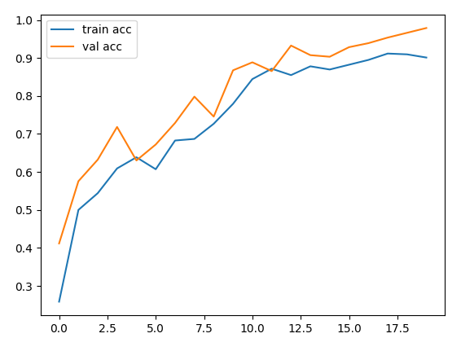
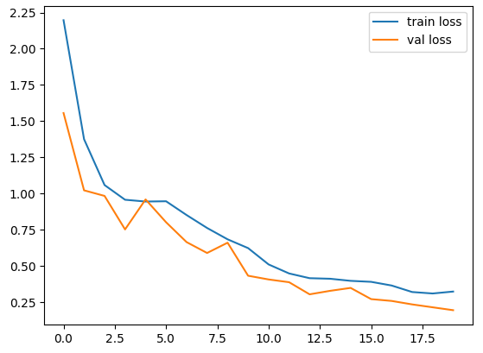
Screenshots
Fig: Accuracy
Fig: Loss
Accuracy: The dataset was trained for 20 epochs. Accuracy is a metric that measures how well a model's predictions match the actual labels. It is calculated as the ratio of correctly predicted samples to the total number of samples in the dataset. A higher accuracy indicates better model performance.
Loss: Training loss measures the error made by the model on the training dataset. It shows how well the model is learning the patterns from the training data. A lower training loss indicates better performance on the training set. It is calculated as the sum of errors for all samples in the training dataset.

Slide 15
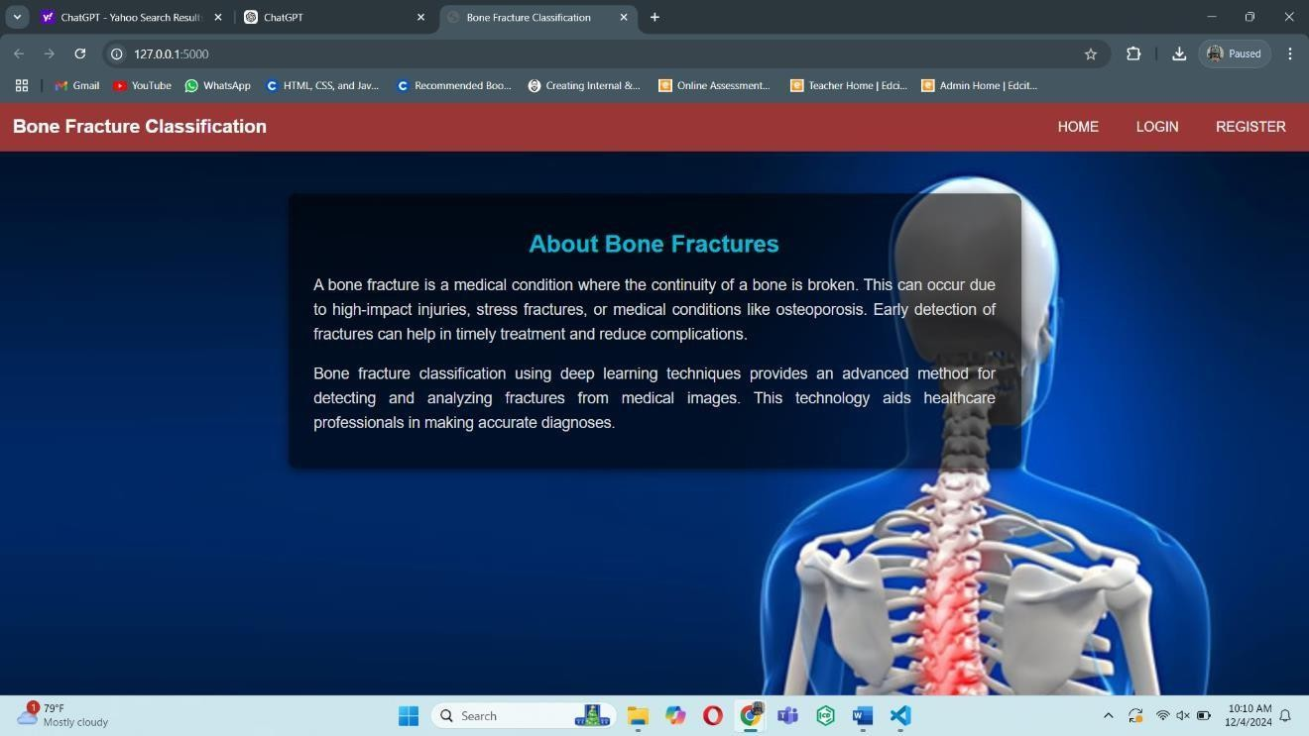
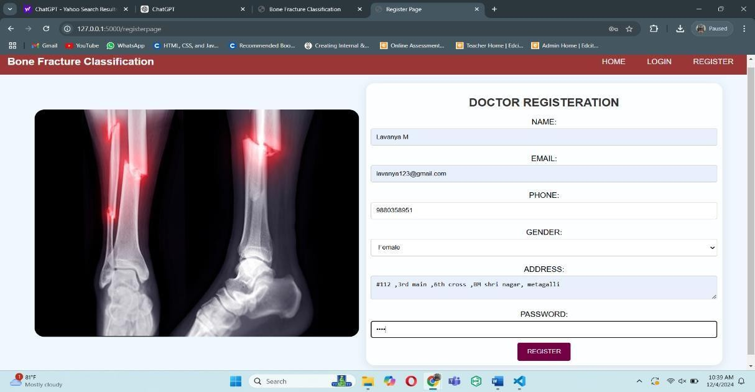
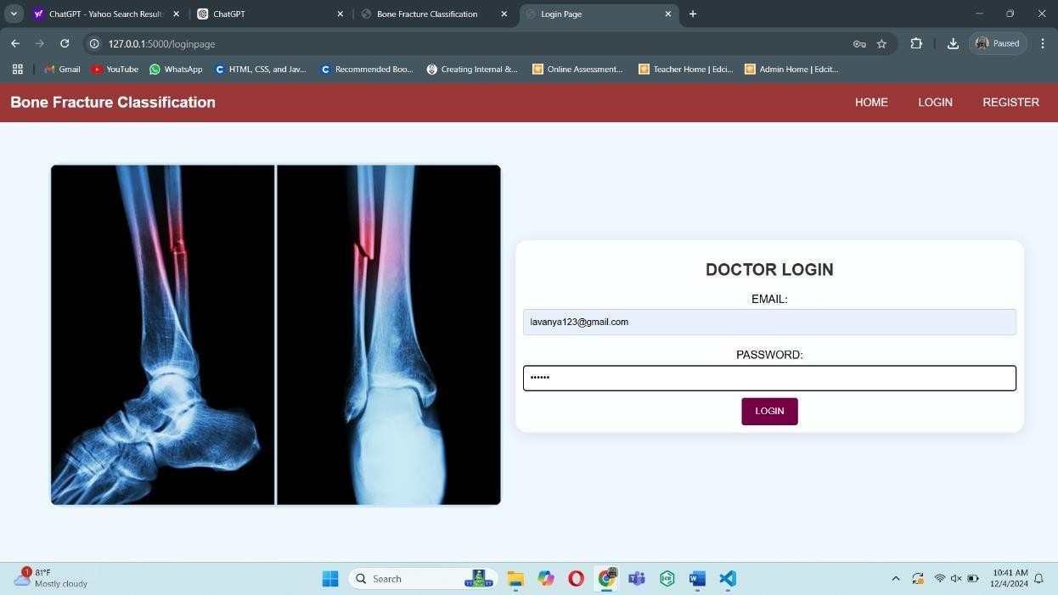
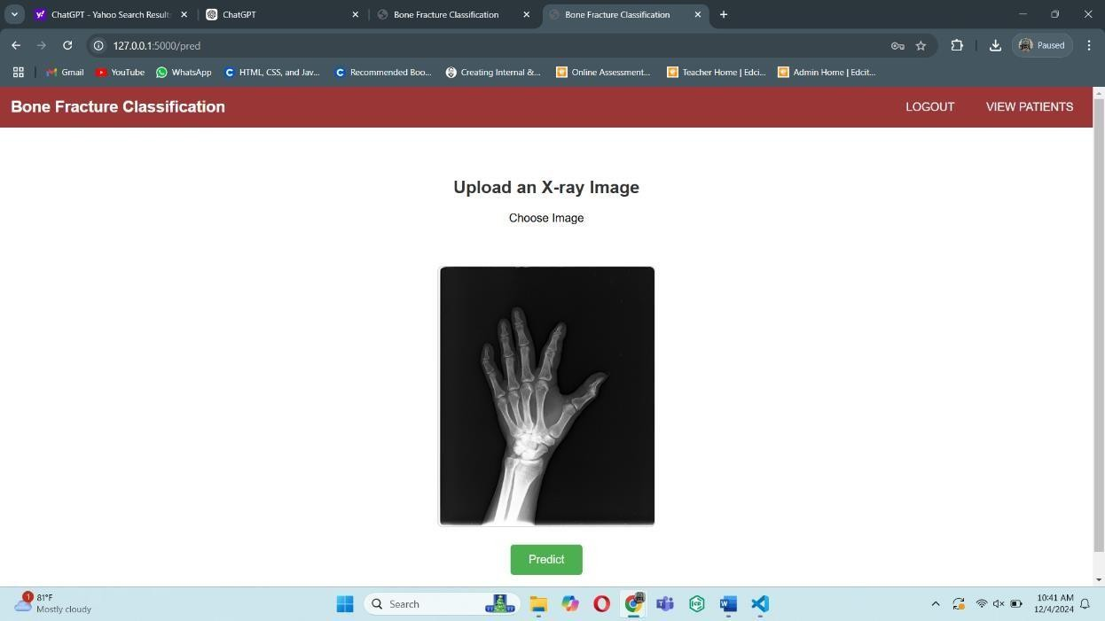

Slide 16
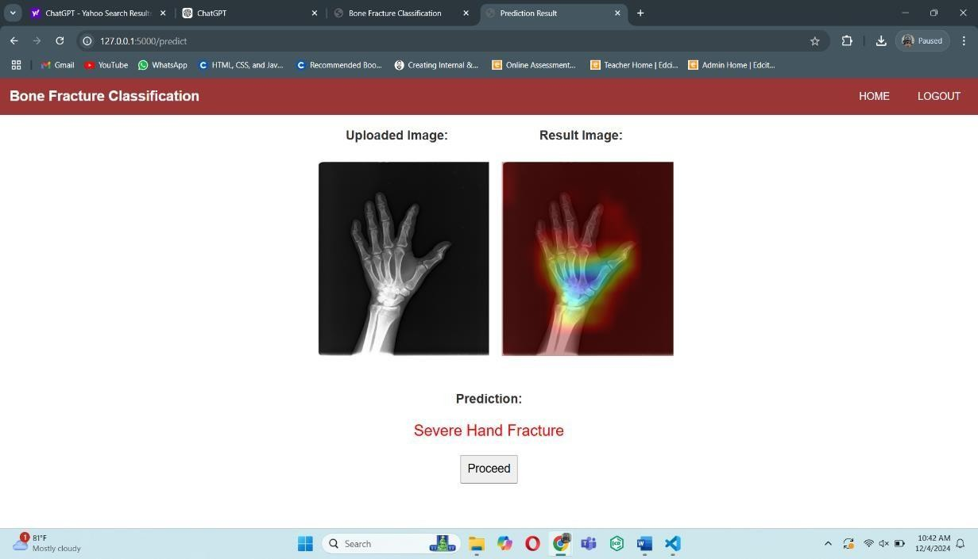
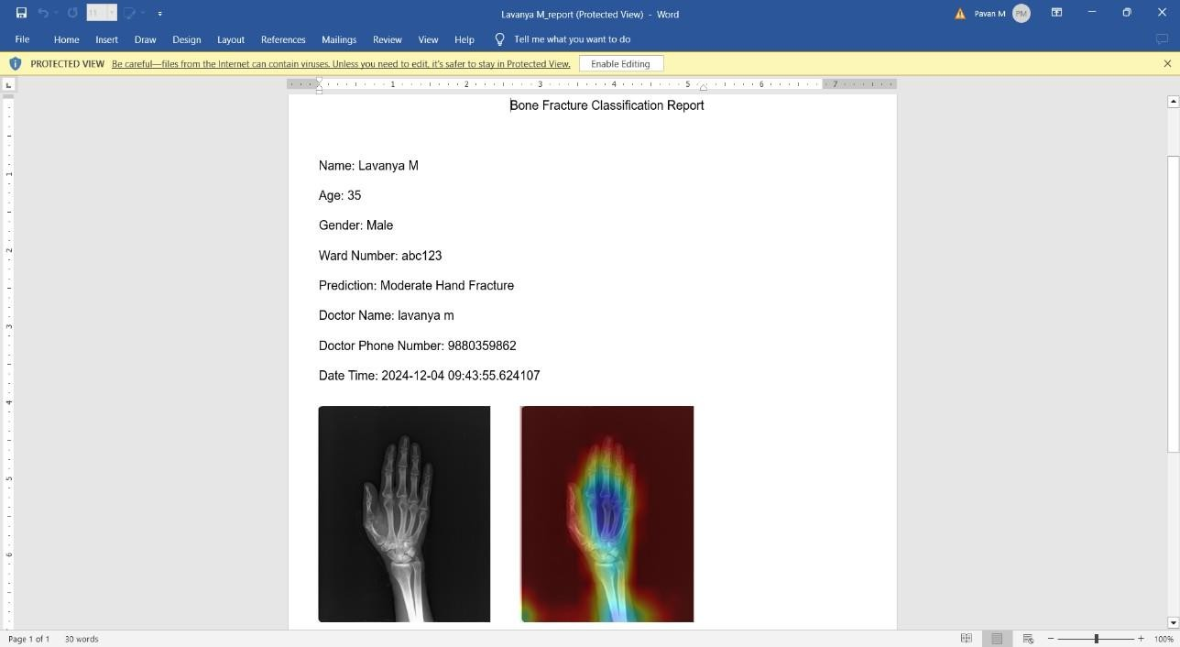
Screenshots

Slide 17
Test Cases
No | Input | Expected output | Actual output | Result
1 | Doctor registration enter name, email id, phone, gender, address, password | Check email or phone number already exist, if exit display message email or phone number already exist, else display registration success | Registration success | Pass
2 | Doctor registration with existing email or phone number | Display message email or phone number exist | Email or phone number exist | Pass
3 | Login , enter valid email and password | Display pred.html page | Pred.html page displayed | Pass

Slide 18
Test Cases
No | Input | Expected output | Actual output | Result
4 | Upload x ray image | Display classified result | Classified result displayed | Pass
5 | Upload x ray image and click proceed button after classification. | If result is mild display form to enter patient details , tablets and description | Form displayed to enter patient details , tablets and description | Pass
6 | Submit patient details form | Generate pdf with details and save details | Pdf generated and details saved | Pass

Slide 19
Advantages and Applications
Advantages:
Improved accuracy and consistency in fracture classification.
Reduced human error compared to manual assessments.
Faster analysis of X-ray images, aiding in quicker decision-making.
Educational benefits for training medical students and professionals.
User-friendly interface for easy operation by healthcare professionals.
Application:
Emergency Care: Provides immediate analysis in emergency situations to prioritize treatment.
Research and Development: Aids researchers in analyzing large datasets to identify patterns in fractures and treatment outcomes.
Mobile Health Apps: Integrates with mobile applications to allow patients to upload images and receive preliminary assessments.
Telemedicine: Supports remote consultations, enabling specialists to assess X-ray images from distant locations.

Slide 20
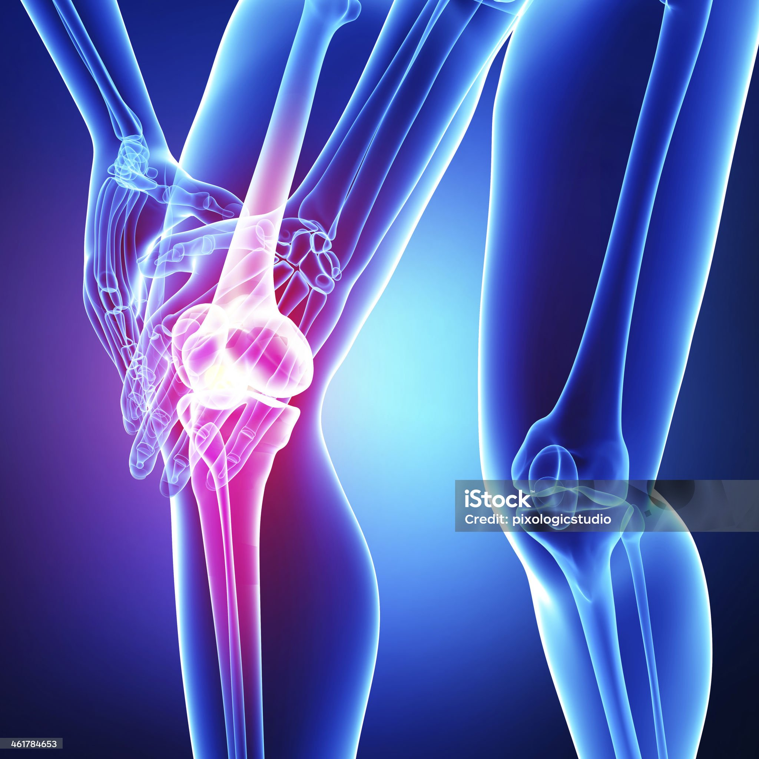
Conclusion
The Bone Fracture Classification System developed using the VGG16 deep learning algorithm and Flask web framework presents a valuable solution for automating the classification of bone fractures in X-ray images.
By accurately categorizing fractures into Mild, Moderate, and Severe categories, this system improves diagnostic efficiency, reduces human error, and offers instant, reliable results.

Slide 21
References
Yadav, R. S., & Shrivastava, P. K. "Detection of Bone Fractures from X-ray Images Using Faster R-CNN.” Computer Vision in Medicine, vol. 12, 2020.
Bar, S., Diamant, G., & Wolf, D. "Automatic Detection of Bone Fractures in X-rays Using Deep Learning Models." Medical Imaging Research, vol. 9, no. 4, 2021.
Cheng, K. M., Ho, A. P., & Niu, Z. "A Deep Learning Approach for Fracture Detection in Radiography." Journal of Medical Imaging, vol. 6, no. 1, 2022.
M. H. Aly, A. M. Hassan, A. M. Amin, "Fracture Detection in Wrist X-ray Images Using Deep Learning-Based Object Detection Models," Journal of Biomedical Informatics, vol. 135, pp. 142-153, 2023.
Zhang et al., "Robust Medical X-Ray Image Classification by Deep Learning with Multi-Versus Optimizer," 2023.
Amal Alshahrani, Alaa Alsairafi, "Bone Fracture Classification using Convolutional Neural Networks from X-ray Images," 2024.
Robert Hruby, Daniel Kvak, "Cross- Centre Validation of Deep Learning Model for Musculoskeletal Fracture Detection in Radiographic Imaging: A Feasibility Study," 2024.
Jitendra Chautharia, "Pediatric Fracture Detection with X-ray Images Using YOLOv8," 2024.
S.N. Kadry, H. Maghraby, "Long bone X-ray fracture classification using machine learning", Journal of Al-Azhar University Engineering Sector, vol. 19, pp. 121-133, 2024.
https://www.geeksforgeeks.org/flask-tutorial/.
https://builtin.com/data-science/transfer-learning.
https://www.geeksforgeeks.org/introduction-convolution-neural-network/.
https://www.geeksforgeeks.org/vgg-16-cnn-model/.
https://www.geeksforgeeks.org/understanding-activation-functions-in-depth/.

Slide 22
Thank
You

